Slide 1
Power Transforms

Slide 2
Data transforms
Data transforms are intended to remove noise and improve the signal in time series forecasting. There are many transforms to choose from.
Learn how to identify and when to use and explore
Square root transform.
Log transform
Box-Cox transform to perform square root, log, and automatically discover the best power transform for the dataset.
Dataset: Airline Passengers dataset as an example. This dataset describes the total number of airline passengers over time.

Slide 3
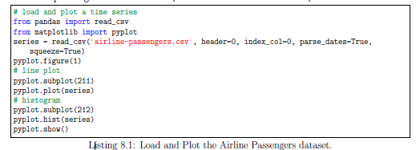
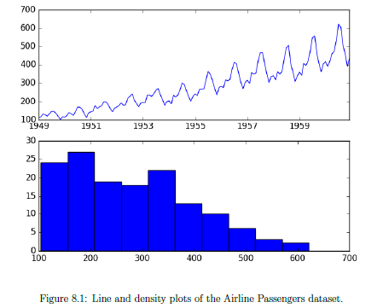
Data transforms

Slide 4
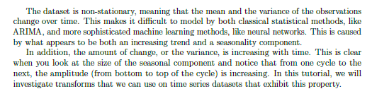
Data transforms
Non stationary
Trend+Seasonality
Variance increasing with time (see amplitude increase)
Modeling becomes difficult

Slide 5
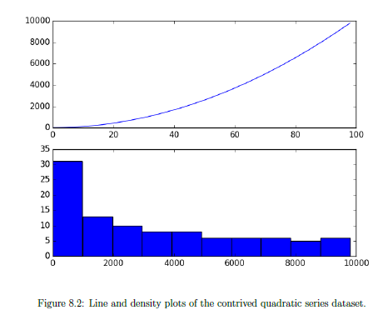
Sq Root Tfm
A time series that has a quadratic growth trend can be made linear by taking the square root.
Consider a series of the numbers 1 to 99 squared.
A quadratic growth trend. This can be removed or made linear by taking the inverse operation of the squaring procedure, which is the square root.

Slide 6
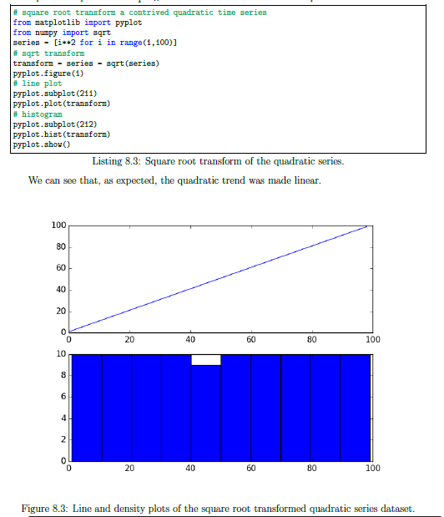
Sq Root Tfm

Slide 7
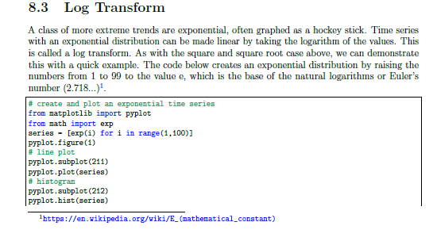
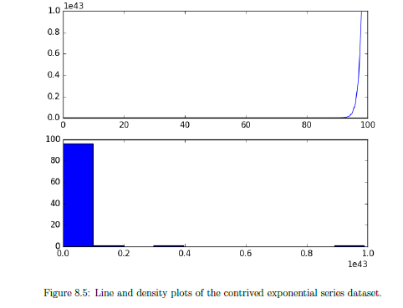
Log transforms

Slide 8
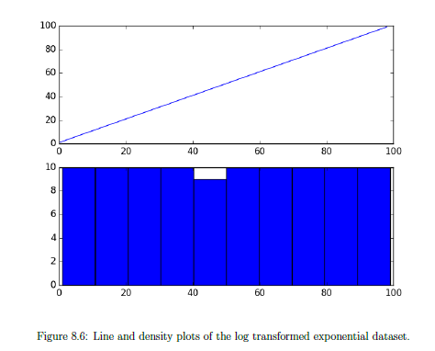
Log transforms

Slide 9
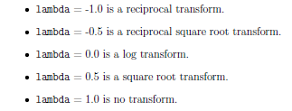
Box-Cox Transform
The square root transform and log transform belong to a class of transforms called power transforms.
The Box-Cox transform is a configurable data transform method that supports both square root and log transform, as well as a suite of related transforms.
It can be configured to evaluate a suite of transforms automatically and select a best t. It can be thought of as a power tool to iron out power-based change in time series.
The resulting series may be more linear and the resulting distribution more Gaussian or Uniform, depending on the underlying process that generated it.
The scipy.stats library provides an implementation of the Box-Cox transform. The boxcox() function3 takes an argument, called lambda, that controls the type of transform to perform. Below are some common values for lambda:

Slide 10
Box-Cox Transform
We can set the lambda parameter to None (the default) and let the function find a statistically tuned value.
Returns both the transformed dataset and the chosen lambda value.
Box-Cox transform can automatically optimize the transform for a dataset.

Slide 11
Practice Lab

